Slide 1
Zombie Invaders
By Kris Andrews and Jose Espinoza

Slide 2
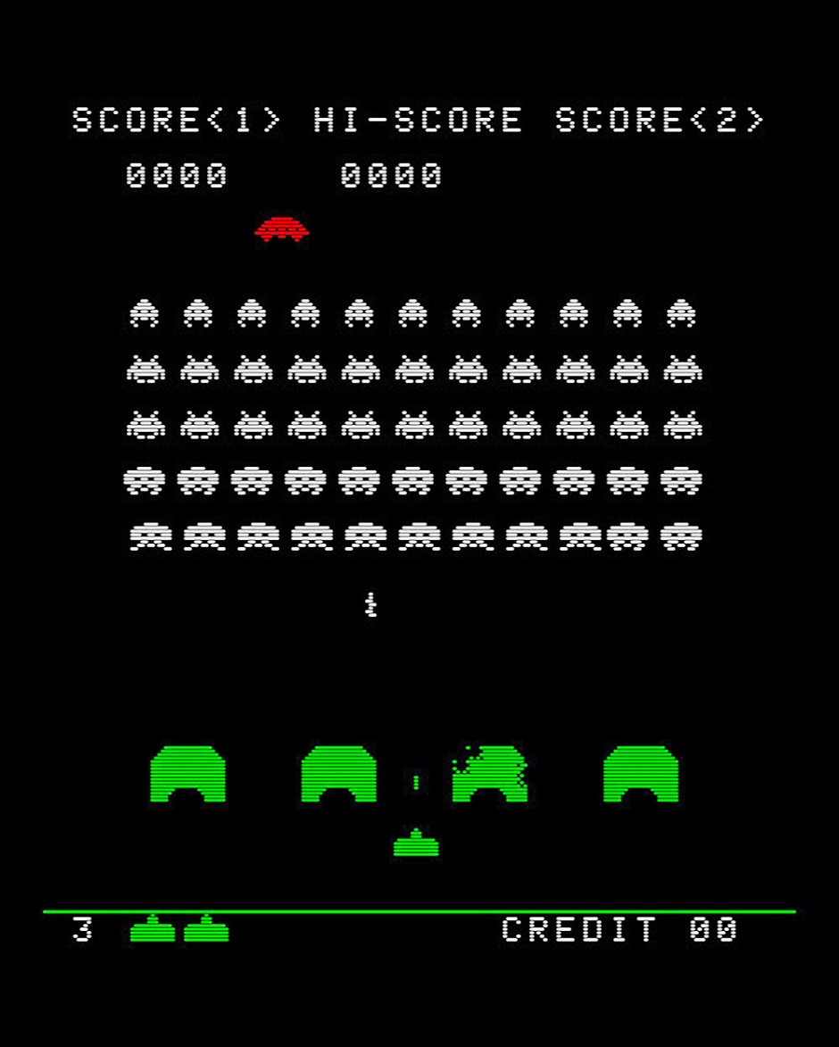
Introduction
Space Invaders type game
Single Player

Slide 3
Requirements
4 screens: start, game, win and game over
start, exit and yes/no buttons
Keep track of score and lives
Zombie, Shotgun, Projectile and Tombstone character models
Zombie’s descend on timer
Shotgun character can move horizontally with keyboard
Space bar fires shotgun
Shotgun fires projectile, if Zombie is hit that specific model is removed from game and score counter increases
Life counter depletes if zombie reaches bottom of screen, when life = 0, game over screen will appear
Tombstones act as barriers and are destructible

Slide 4
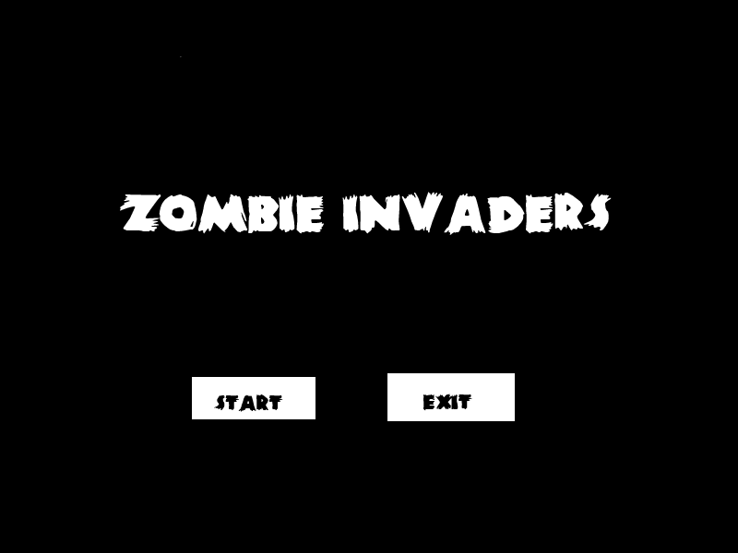
Prototype (Start Screen)

Slide 5
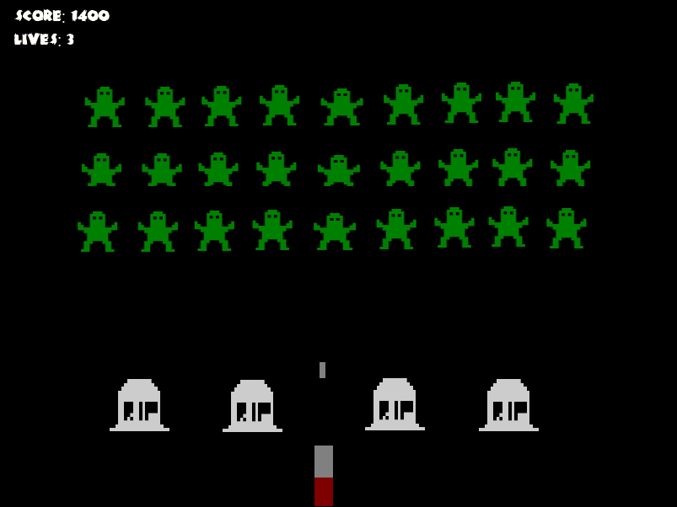
Prototype (Game Screen)

Slide 6
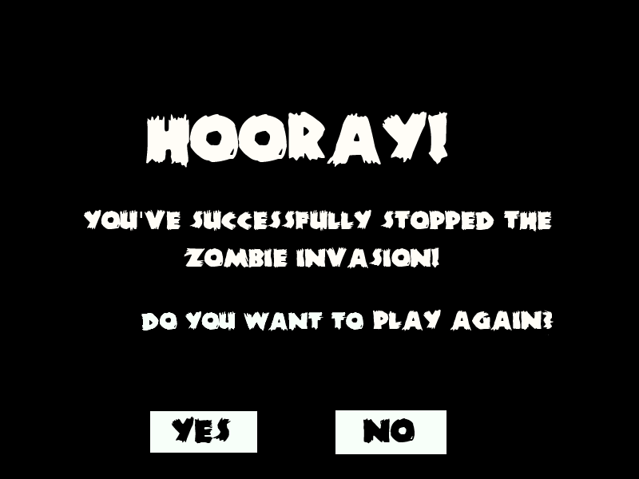
Prototype (Win Screen)

Slide 7
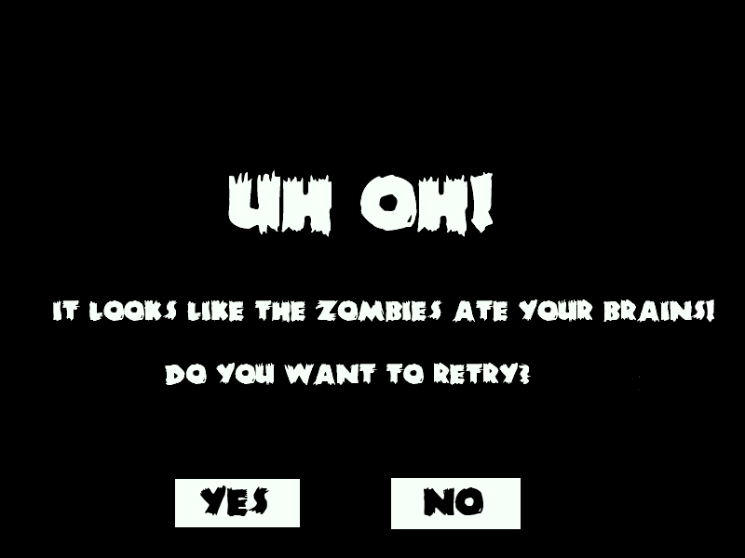
Prototype (Game Over Screen)

Slide 8
References
http://en.wikipedia.org/wiki/Space_Invaders
http://www.fontspace.com/category/zombies
http://make8bitart.com/
(used Paint.net and G.I.M.Pshop to create screens)

